Slide 1



Bonsai On A Budget
Alex Labram
MMM YYYY
Nemeta Bonsai
nemeta.co.uk

Slide 2
Learning Outcomes
Good enough
Theory
Be aware of the history and culture of bonsai
Understand (at a high level) how a bonsai is produced
Understand (at a high level) what distinguishes good and bad bonsai
Know how to maintain a bonsai on a day-to-day basis
Experience the key activities of re-potting, pruning and wiring
Be aware of inexpensive options for further learning and practice
Practical
Watering bonsai
Wiring a bonsai pot for re-potting
Exposing the nebari
Potting the prepared tree
Pruning for bulk, congestion and taper
Wiring for shape

Slide 3
Bonsai: What & Why
Good enough
Defining bonsai
A bonsai is a living trompe-l’oeil: a small tree that appears to be a scaled-down large tree.
Almost any kind of tree can become a bonsai (plus a few things that aren’t trees!)
“Bonsai” traditionally referred to Japanese schools, but has become a generic term
Why ’Sai?
Hands-on education in plant science!
Learn to see extra layers of beauty in nature
Good practical hobby with interesting culture
Sense of control and responsibility
To see a World in a Grain of Sand
And a Heaven in a Wild Flower
Hold Infinity in the palm of your hand
And Eternity in an hour
- William Blake

Slide 4
Bonsai: A Potted History
Good enough
China
Daoist mysticism: recreation of magical sites in miniature
Penjing (盆景) / Penzei (盆栽) = the art of miniature landscapes (pre 600AD)
Popular amongst Buddhist monks, and – later – aristocracy
Heavily impacted by Mao’s Cultural Revolution: seen as a bourgeois pastime
Japan
First records c. 1200AD; known as Hachi-no-Ki (“potted trees” – also the name of a famous play!)
Heavy Zen / Chan Buddhist influence: beauty through austerity, sophistication in simplicity and perfection from imperfection (“wabi-sabi”)
Increasingly popular from 1800s onwards; term “bonsai” (盆栽 – “tray planting”) adopted
Development of distinct styles (dramatic archetypes)
Hit hard by World War 2, but revived in the aftermath (partly from enthusiasm of GIs)
Exported to West from 1960s onwards, in parallel with Japan’s “economic miracle”

Slide 5

Bonsai: Art & Science
Good enough
Good bonsai practice is:
Authentic - makes you think “tree”
Tree as biological / ecological process
Dramatic – makes you think “TREE”
Tree as compositional element
Pragmatic – doesn’t make you think “dead tree”…
Tree as living clay

Slide 6
Pragmatism 1
Good enough
How Not To Kill Your Tree

Slide 7
What Kind Of Tree Is A “Bonsai”, Anyway? Trick question alert!
Tree: “a large, tall, woody, perennial plant with a single, unbranched, erect, self-supporting stem holding an elevated and distinct crown of branches with a total height greater than ten feet and a diameter greater than three inches” – oy vey!
Almost any tree species can be trained into a bonsai; many smaller plants can too
Requirements for bonsai-ing:
Vascular plant (no mosses!)
Woody growth / “lignification” (no daisies!)
Secondary growth of trunk (no palms!)
Free-standing (no lianas!)
Deep roots (no grasses!)
Desirable features
Attractive / interesting species
Small or pinnate leaves
Long-lived
Reasonably fast-growing
Easy to maintain / shape
“Honorary” bonsai species
Woody climbers: ivy, wisteria, honeysuckle
Succulent / fleshy: dwarf jade, geranium
Chrysanthemum

Slide 8
I Had One Once, But It Died What a bonsai needs to survive
Environment
Indoor vs Outdoor
Watering!!!!!
Single biggest killer of bonsai
“Root hairs” die easily in drought
Over-watering is also dangerous!
Light
Heat
Dormancy
Airflow
Pest Control
Animals: spider mites, scale bugs, aphids, caterpillars, vine weevil, squirrels
Plants etc: pearlwort, liverwort, wood sorrel, pennywort, nostoc
Caution: environmental issues!
Fertiliser
“Balanced”: roughly even NPK
Organic => micronutrients
Caution: environmental & ethical issues!
Bonsai are far harder to keep alive than most common pot plants!

Slide 9
Watering Your Bonsai No, seriously, this is important
Why so serious?
Trees usually have deep tap-roots to draw water; they don’t handle drying out well
…Especially conifers, for some reason
Good-quality bonsai soils / pots have really good drainage… so can dry off quickly
Bonsai soil is very compact and often moss-covered… so water tends to run off the surface
Traditional bonsai soil is inorganic, so lacks the “capillaries” of plant fibre that let water rise up through the pot
Even gardening experts routinely kill their first bonsai!
Watering methods
Put in bucket of water (to just below brim) and wait for water to bubble up
…Then take out and allow to drain fully. Never leave standing in water for long periods – roots need oxygen too!
Water from above three times, allowing the water to sink in between passes
Is it watered enough?
Surface feels damp to back of hand
Pot significantly heavier
Water running out of hole in bottom

Slide 10
Authenticity & Drama
Good enough
Thinking Like A Tree (That’s Seen Some S**t)

Slide 11
Arboriculture 101 What shapes a tree?
Sunlight
Airflow
Gravity / load
Shade
Animals

Slide 12
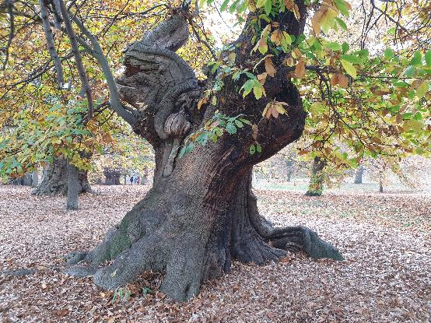
Authenticity & Age What makes a tree look mature?
Canopy shape
Rounded triangle
Composed of rounded-triangle “pads” (for species that back-bud less readily)
Trunk & branch behaviour
Short inter-node distance
“Ramification”: fractal splitting of branches
“Square-cube law”: big tree = proportionally heavier load = more curvature
“Ruptures”: jagged direction changes
Texture
Bark
Dead-wood: advanced bonsai topic!
Taper
“Nebari” (根張り) = root flare / buttress
Trunk & branch flare: from base to apex / tip
Trunk-to-branch (and branch to sub-branch) ratio

Slide 13
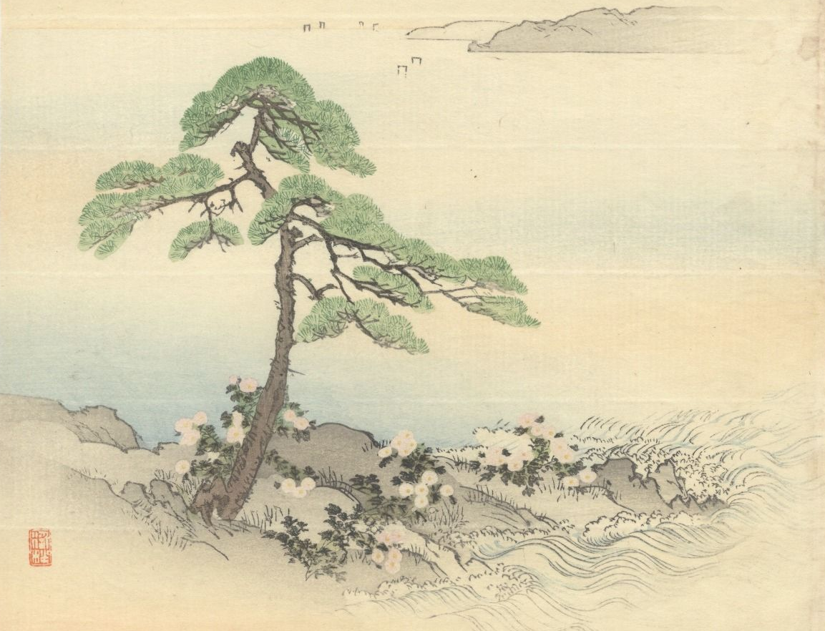
Art à la Japan Catching the eye
Key elements of visual design:
Movement & rhythm
Balance: symmetry vs asymmetry
Similarity & harmony vs contrast & variety
Perspective & proportion
Repetition & continuation
Unity: wow factor
Japan-specific additions:
“Wabisabi” (侘び寂び – literally “forlorn rusticism”): austere, naturalistic, often hard-worn beauty and elegance
Top-right to bottom-left traditional reading
It is self-evident that nothing concerning art is self-evident.
- Theodore Adorno (1969)

Slide 14
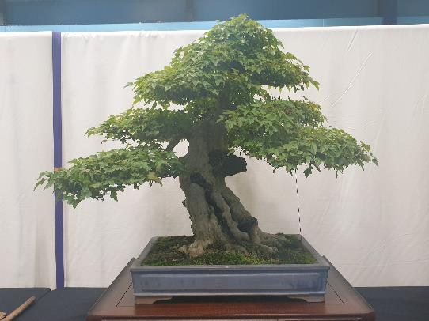
Drama & Perspective What makes a tree stand out?
Taper (again!)
Taper appears stronger from viewpoint at base of tree
Pot: picture-frame for tree
“Heavy” earthenware vs “light” glazed
Depth ≈ trunk thickness; width ≈ 2/3 canopy height (tall tree) or width (wide tree)
Style: heavy vs light, plain vs ornate
Use of negative space
…Often in imitation of wind-flow or trunk death in full-scale trees
Scaled-down decorations
Moss “grass”, accent plants, rocks (“suiseki”)
Well-defined “front”
Style is firmly established
Sense of strength or movement captured
Clear view of lower trunk
No crossed branches
Tree’s “centre of mass” is in middle of pot

Slide 15
Flaws What gives the game away?
Obvious tool marks
…Including wire scarring
Excessive symmetry
…Especially handlebar branches
Asymmetry is a common theme in Japanese gardening!
“Reverse taper”
Unusual “habit” for species / genus
Google for pictures of wild tree to get ideas!
This rule is frequently ignored: e.g. small shrubs portrayed as large trees, boringly-shaped species made interesting, unrealistic pads
Dead leaves and (unwanted) deadwood
Weak / immature-looking branches
Suckers
Congested nodes
Under-slung / elbow branches
Lack of clear “leader” (dominant trunk / branch)

Slide 16
Bonsai Styles The most common four archetypes of… thirty? Really?!?
Formal Upright
Cascade
Strong, proud, “yang”
Pot: unglazed earthenware; simple shape; bulging
Can be hard to develop taper, especially on conifers
Flowing, falling
Pot: deep to make space
“Half-cascade” runs to base of pot; “cascade” goes below that
Informal Upright
Literati
Relaxed, elegant, “yin”
Pot: glazed; fluting; flowery
Broad range of possible shapes
Basically the default style!
Solitary, melancholy, bleak
Trunk: bare, ruptured, calligraphic
Pot: small to emphasise plant’s extravagant loneliness
Style derived from woodcuts in classic Chinese drawing guide

Slide 17
Pragmatism 2
Minor graphics fixes x3
Making Life In Miniature

Slide 18
Bonsai Lifecycle
Add cartoons for each stage
Make flow diagram less monochrome
Sources
Training
Refinement
Slow
Seeds
Cuttings
Fast
Garden centre seedlings
Scavenging
Pot-ready
“Nonsai”
Garden centre mature trees
Yamadori
Display
Exhibition
Photography
On-boarding
Grow out
Re-pot
Prune
Wire
Cut back
Major intervention
Restyling
Air layering
Deadwood
Dead ☹

Slide 19
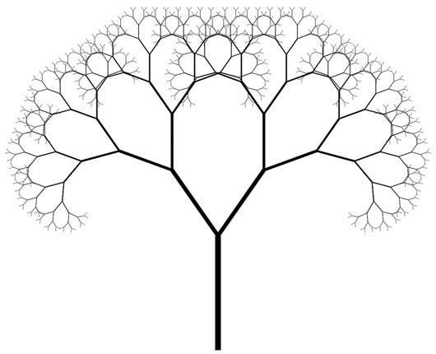
Why We Prune It’s not just repressed sadism, honest
Good enough
Shape the tree
“Structural” pruning to shape trunk + primary branches and fit a bonsai style / archetype
Canopy pruning to create rounded-triangle shape(s)
Shape the branch - encourage ramification and taper
Encouraging lateral growth by removing terminal / apical buds
Continuing the ramification process past the eye’s limits makes judging scale difficult and creates the illusion of great size
Pick winners - before the tree can pick for us!
Improve spacing and remove congestion and “fluff”
“Balance energy”: force growth away from the apex towards more interesting (to us) areas
Crowd management - reduction of green mass
Let light through to lower areas of the tree (pruning for “inner growth”)
Reduce water shock when re-potting

Slide 20
Botany & Pruning (1) Not all trees are alike
Good enough
Apical
Types of growth
Apical growth from the tip of the trunk
Terminal growth from the tip of branches
Lateral growth from behind the tip
Adventitious growth from the base of branches
Epicormic growth from random spots on the trunk
Back-budding (adventitious + epicormic*): Weak back-budding → we have to plan further ahead (e.g. leave sacrificial branches) to thicken the trunk
Lateral growth: Dense lateral growth → we have to think in terms of zones along each branch instead of looking at individual sub-branches
Apical dominance: Some trees (conifers especially) grow more strongly upwards
Flushes per year: Usually two (Spring and Lammas) except for mountain-growing pines
Terminal
Lateral
Adventitious
Epicormic
* Warning: botanists use “back-budding” to mean something different!

Slide 21
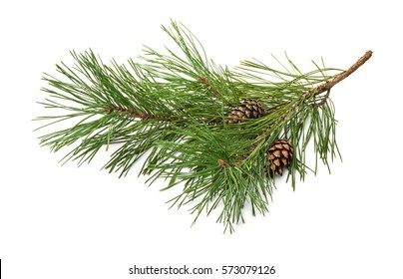
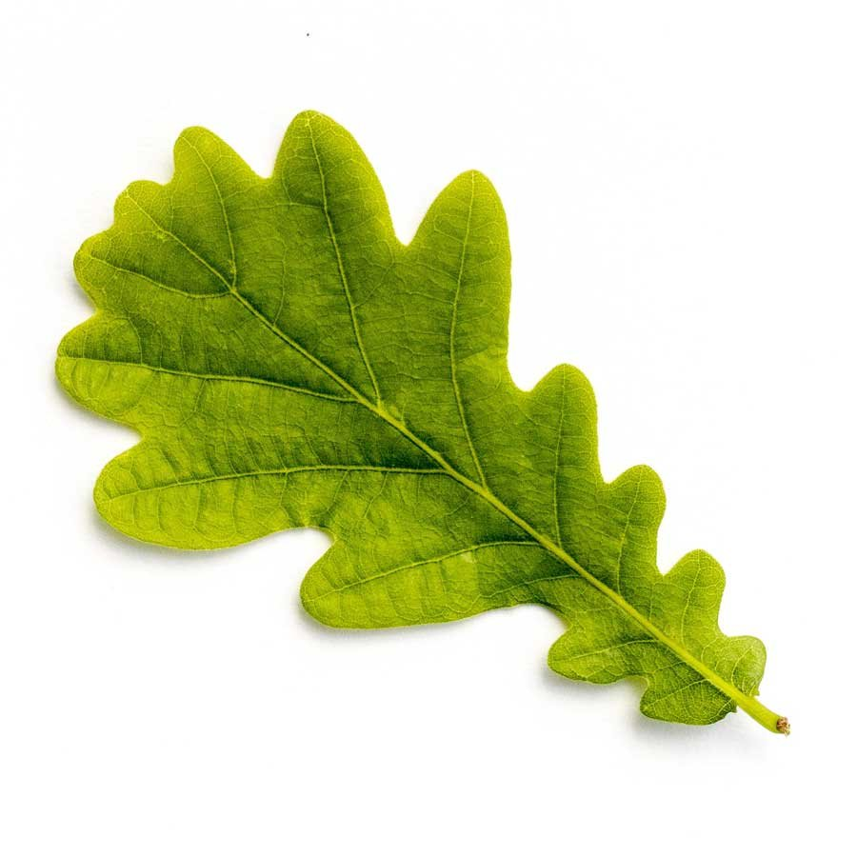
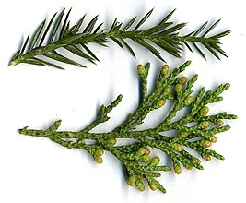
Botany & Pruning (2) Three main types of foliage
Replace or attribute pics!
Needle-bearing
Broadleaf
Spiky / scaly

Slide 22
Structural Pruning Building a solid foundation
Good enough
Goals
Select an appropriate style for the tree
Identify and establish the trunk and first few branches of the bonsai
Mark out sacrificial branches to thicken the trunk / nebari
During the tree’s “training” phase: make the most of fast woody growth
Create a base for subsequent development of smaller branches and canopy
Approach
Start from the base
Clear branches from the lower trunk
Or mark for later removal, in which case remove all side-growth to avoid wasted energy
Working up the tree, at each node remove all but two branches

Slide 23
Pruning for Ramification (1) Broadleaf trees: playing in easy mode
Good enough
Context
Can handle loss of mass
Back-buds readily
Leaves may be simple or compound, alternating or opposite
Goals
Reduced bulk of foliage
Minimal wasted growth
Strong taper along branch
Approach
Once a branch is well-established, cut it back to “two heirs and a spare” (at least)
The spare is a sacrificial branch: it can be removed later if the heirs survive
One sub-branch will become the new “leader”; the other will be a side-branch
Allow to
grow out
Repeat for each new branch
Pinch off tip
Wait for buds to burst
Wait for buds to burst
Cut back
to 3 nodes*
* Or 2 nodes (4 buds) for opposite leaves

Slide 24
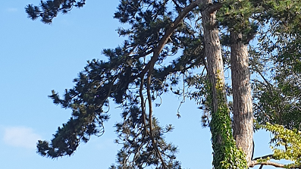
Pruning for Ramification (2) Needle-bearing trees: getting trickier
Good enough
Context:
No epicormic growth
No lateral growth from old (needle-less) wood
Often weak adventitious growth
Often strong apical dominance
Goals
Green growth should form pads / clouds or layers, floating above the branch
Remove needles from trunk and base of branches to create old wood and permanently restrict future growth
Control apical growth carefully to stop premature die-off of lower branches (“energy balancing”)
Cutting back tips (removing current-year terminal growth) is called “de-candling”
Approach
Create ramification and taper following the same process as for broadleaf trees
…but leave some lower branches as sacrificial branches to thicken the trunk
Be sure that each new branch has some foliage at its tip, or it will die
Don’t panic if you have long branches without side-shoots: these can be made more compact by wiring!

Slide 25
Pruning for Ramification (3) Spiky / scaly trees: super fiddly
Good enough
Context:
No epicormic growth
Lateral growth is already present!
Short inter-node distance
Spiky foliage = immature scaly foliage
Goals
Green growth should form pads or layers along the branch
Branches should form fractal “fishbones”
Approach
Remove branch tip (Zone D) entirely;
Remove growth out of the layer (i.e. up or down if branch is horizontal)
Remove growth in Zone A;
Thin out growth in Zone B;
Shape-prune growth in Zone C
…Then repeat for each branch in Zone B
6
3
5
1
6
4
A
B
C
D
A
B
C
4
6
3
5

Slide 26
Wiring The rules guidelines
Good enough
Goals
Imitate the effect of gravity on full-size tree branches (“square-cube law”)
Make straight branches look like they’re the product of many shorter segments
Spread branches to avoid shading each other
Fill unwanted gaps in the canopy
For conifers: bring foliage closer to trunk
Approach
If it’s daft and it works, it’s not daft
We use anodised aluminium wire because it is easy and attractive. Weights, strings, corks, rubber bands, etc are all completely valid alternatives!
Use the thinnest gauge of wire that will still bend the branch
E.g. if either 2mm and 1.5mm would work, but 1mm wouldn’t, use 1.5mm
Always wire two branches together!
…Or wire a branch to the trunk, or the trunk to the root ball / pot; just don’t try to wire a single branch on its own
Wire at 45º to the branch / trunk
Rule of thumb: the wire needs to be the length of branch / trunk to be wired × 1.5
The wire is a cage not a corset
I.e. use as little pressure as possible: the less it digs in on Day 1, the longer you have before it leaves wire-marks on the bark
It’s OK to leave an “open coil” spiral at the end to gently control green growth
Leave wire on for one growth season
Usually 6 months – covering either Spring or Lammas growth - except for some mountain pines which only have one growth flush per year
If the branch hasn’t “set” after one flush, you just have to reapply the wire

Slide 27
Stress Management …No, I meant for the tree
Good enough
Sources of water stress
Root pruning
Under-watering
Over-watering / poor drainage → root rot
Over-fertilising
Summer
Sources of wood stress
Heavy removal of green growth
Branch removal past the “collar”
Some kinds of deadwood work
Insect attacks
It’s best to space stresses out over as much time as possible – e.g. 1 major stress per tree per growth season
Water stress and wood stress are not (necessarily) additive: if you prune the foliage and the root ball, there is less demand for water so less work for the remaining roots

Slide 28
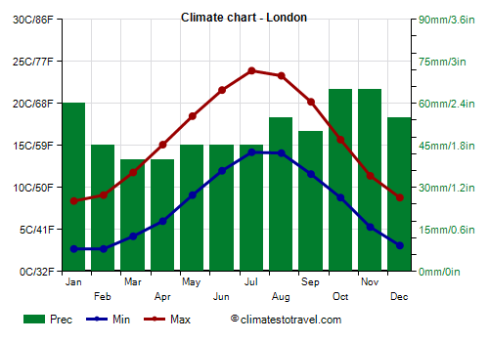
There Is A Season When to do what
Replace chart with own analysis (it’s all public data)
Winter
Spring*
Summer
Autumn
Dormancy
Light watering
Frost protection**
Cleaning & tidying
Stock up on growth media
Spring growth
Moderate watering
Moderate fertilising
Pest control & weeding
Re-potting (every 1-3 years)
Structural pruning if needed
Wiring / wire removal
Sun & heat
Heavy watering***
Very light fertilising
Enough shade (species dependent)
Lammas growth
Moderate watering
Mild fertilizing
Pest control & weeding
Pruning for ramification
Wiring / wire removal
* Spring for bonsai practitioners (especially in London) typically starts earlier than the calendar date
** Not usually needed in present-day London due to the heat island effect and global warming
*** If going on holiday, put bonsai in bath with enough water to just barely touching the soil through the pot drainage holes

Slide 29
Next Steps
Good enough
Becoming a Bonsai Practitioner

Slide 30
Practice, Practice, Practice Practice, practice, practice, practice… you get the picture
Keep your tree alive and bonsai-ish
Remember: WATERING!!!
Remove wire in ~6 months
Find rogue seedlings to “adopt”, and transfer them to pots
…Without killing them, I mean
Once you’re sure they won’t die, prune them and gradually move them to smaller / shallower pots
Start to build a bonsai toolkit
Start with cheap / improvised tools: chopsticks, pliers, wire-cutters, tamper, nail scissors
Consider buying: root shears, straight-edged branch cutter
Build a collection of pots for all bonsai styles and phases of development
Make your own – e.g. with crockery and a diamond tile hole saw
Contemplate trees in nature
What principles do they reflect, and how did they get that way?

Slide 31
Learn From Others Apart from yours truly
Buy a book
I like the DK Bonsai book: https://www.dk.com/uk/book/9781409344087-bonsai/
UK Bonsai Association: https://www.ukbonsaiassoc.org
Local clubs
Currently none in central London, but several out in the suburbs
The UKBA site has a very complete list (albeit not the easiest to search)
Bonsai shows and car boot sales
Again: the UKBA has a calendar
Again: none in central London, but some in Twickenham, Bracknell, Kent…
Youtube
Channels: Mă-Kè Bonsai, Herons Bonsai, Bonsaify, Notion Bonsai, Bonsai Empire, …
Drop me an email! alex@nemeta.co.uk

Slide 32
Thanks For Attending!

Slide 33
H1 H2

Slide 34
Appendices
Add: single-slide “how to spruce”
Miscellaneous Technical Notes

Slide 35
How Often To Water Some key factors
Good enough
Pot
Depth: deep → less frequent
Shape: bulbous → less, fluting → more
Inner surface: glazed → more
Soil
Drainage: well-draining → more
Degradation: older → harder to water
Dressing: dead sphagnum and/or live moss covering → harder to water but less frequent
Tree
Maturity: older → less (in theory)
Fertilisation: heavy → more
Re-potting: recent → more
Environment
Wind: windier → more
Sun: sunny → more, shady → less
Heat: hotter → more, colder → less
Season: Winter = least, Summer = most
Warning: these factors are “non-linear”! A small increase in e.g. sun can mean a big increase in watering.
…Mostly it’s not worth the effort to figure out the “right” watering frequency. Just keep checking the pot every day!

Slide 36
Woody Plants: A Family Tree Evolution From A Bonsai Pruner’s Perspective
Prune as:
Broadleaf
Needley conifer
Spiky / scaly conifer
Special case
Good enough
B
N
S
!
Vascular plants
B
Gymnosperms (“Naked Seed”)
Angiosperms (“Covered Seed”)
Magnoliids
!
Gingko
B
B
Pinaceae (“Pine-like conifers”)
Cupressaceae (“Cypress-like conifers”)
Asterids
Rosids
N
Pine
B
Yew
“True” Cypress
S
Ash
(Crab) Apple
Oak
N
B
S
Spruce
Redwood
Juniper
Elder
Elm
Maple
N
S
S
“True” Cedar
Sugi
“False” Cedar
Rhododendron
Prunus: Cherry, Plum, Apricot, etc
Lime
N
Beech
Larch
Azalea

Slide 37
Wiring a Bonsai Pot What could go wrong?
Good enough
Mesh & Staple
(Plastic mesh, 2mm alum. wire)
Guy wires
(1.5mm alum. wire x 2)
wire above mesh
wire below mesh & pot
wire below mesh
wire above mesh & along sides of pot
one side of each wire longer than the other
view from short side
view from long side
extra bend makes it obvious which is the longer side
guy wire will be held in place by staple

Slide 38
Repotting step-by-step
✓
Good enough
fingers
Regular repotting – often back into the same pot! - helps limit tree size via “root-to-shoot ratio”
1. Prepare pot
Pick a (tentative) pot
Scrub clean
Staple mesh over holes
Add guy wires
2. Prepare tree
Remove from pot
Clean off soil surface
Dig down to expose nebari
Choose “front” if not already clear
Dig up / in to define root-ball
Untangle lateral roots where poss. (esp. girdling roots)
Clear any growth from lower trunk
Spray with water if starting to dry!
3. Insert tree into pot
Add shallow layer of soil to base
Place root ball in pot and pack soil around
Compress soil to “brownie” hardness
Pull guy wires over root ball, twist pairs together tightly, and trim to 3-4 twists
Cover with dried, grated, rehydrated sphagnum and compress surface
Sprinkle with grated acrocarpous (upward-growing) moss
✗
Prone to snapping!
✗
Prone to snapping!

